Slide 1
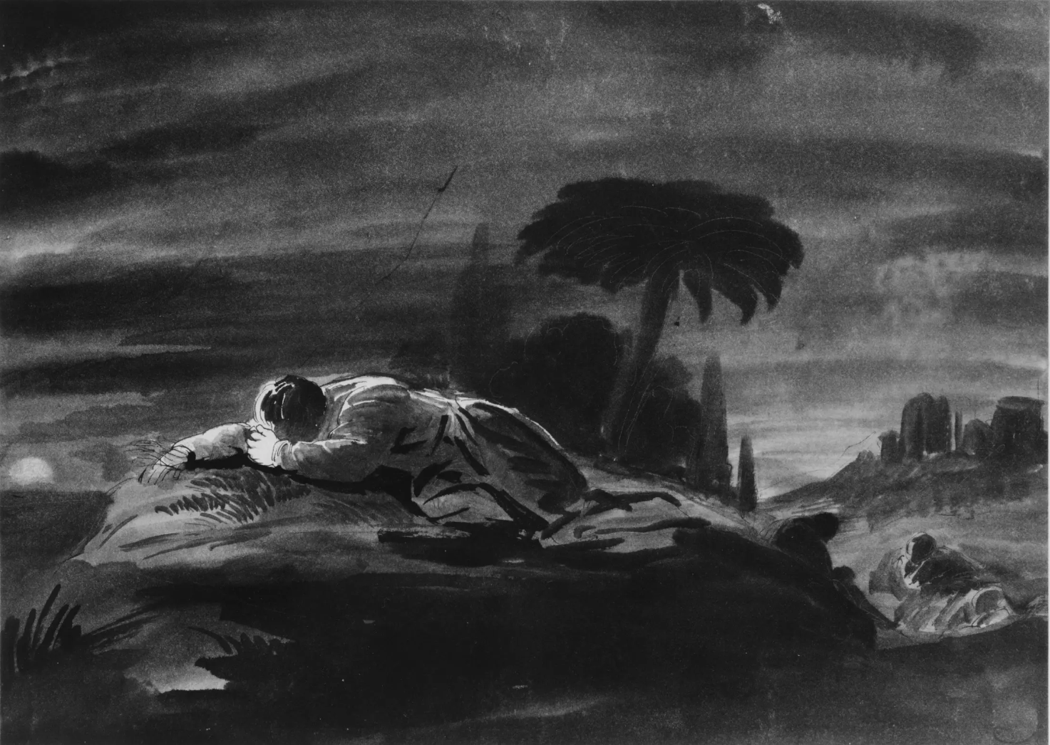
世上的粮/橄榄山头
Bread of the World/
'Tis Midnight and on Olive's Brow

Slide 2
世上的糧因憐憫擘開，
心靈美酒 憐憫傾流，
Bread of the world in mercy broken,
wine of the soul in mercy shed,
世上的粮/橄榄山头 1.1/5

Slide 3
生命話語藉祂而傳開，
因衪受死 我罪得救。
By whom the words of life were spoken,
and in whose death our sins are dead.
世上的粮/橄榄山头 1.2/5

Slide 4
看那心靈為憂傷破碎，
為我眾罪 流下眼淚；
Look on the heart by sorrow broken,
look on the tears by sinners shed;
世上的粮/橄榄山头 2.1/5

Slide 5
主設筵席成為我記念，
我靈得著 豐盛恩典。
And be thy feast to us the token
that by thy grace our souls are fed.
世上的粮/橄榄山头 2.2/5

Slide 6
我等起身 傳主恩豐盛；
筵席雖了 愛未完成;
Too soon we rise, the symbols passing
The feast though not the love is done
世上的粮/橄榄山头 3.1/5

Slide 7
聖體表徵 雖成為過去，
主的同在 仍要持續。
Gone are the symbols of Your body
Yet still Your presence lingers near.
世上的粮/橄榄山头 3.2/5

Slide 8
時已夜半橄欖山頭，
晚星已經幽暗不明。
’Tis midnight, and on Olive’s brow
The star is dimmed that lately shone;
世上的粮/橄榄山头 4.1/5

Slide 9
寂靜客西馬尼園內，
孤單救主懇禱不息。
’Tis midnight in the garden now,
The suff’ring Savior prays alone.
世上的粮/橄榄山头 4.2/5

Slide 10
時已夜半為人罪孽，
救主痛哭血流不已；
’Tis midnight, and for other’s guilt
The Man of Sorrows weeps in blood;
世上的粮/橄榄山头 5.1/5

Slide 11
但是悲傷跪禱之主，
並未被祂聖父遺棄。
Yet He that hath in anguish knelt
Is not forsaken by His God.
世上的粮/橄榄山头 5.2/5

Slide 12
我眾罪孽主全承擔，
救主為你流出 寶血。
The sins of all upon His head
for you the Savior’s blood is shed.
世上的粮/橄榄山头 5.3/5

